Slide 1


Artificial Neural Network (ANN) based control system for induction motors
TEAM MEMBERS
1.Roahiyaa T - CB.SC.U4AIE24043
2.Shivanandana A - CB.SC.U4AIE24049
3.Srinithi K - CB.SC.U4AIE24055
4.Vanishree S - CB.SC.U4AIE24059
1

Slide 2
INTRODUCTION
3-phase induction motors are widely used in industrial and commercial applications.
Known for their robustness, reliability, and low maintenance requirements.
Operate based on Faraday’s law of electromagnetic induction.
Speed control is essential for improving efficiency, performance, and energy savings.
Induction motors are inherently coupled systems, making speed control a challenging task.
Various control techniques exist: Scalar control (V/F), Fuzzy Logic, FOC etc.
V/F (Volts-per-Hertz) method is simple, cost-effective, and suitable for most practical applications.
In this project, a closed-loop V/F control with a PI controller is used for accurate speed regulation.
Implementation is done using MATLAB/Simulink, demonstrating stable speed and torque performance.
2

Slide 3
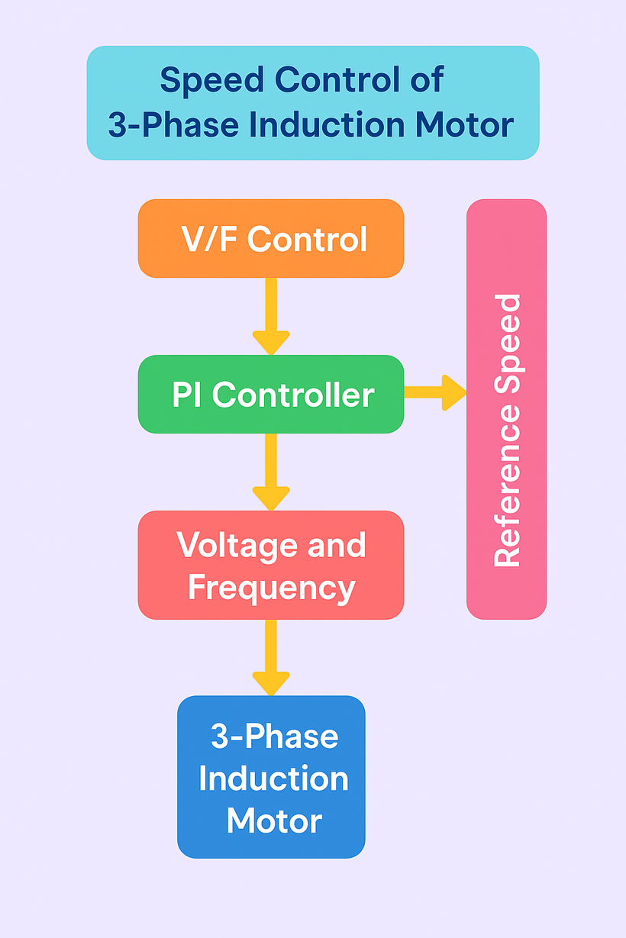
WORK FLOW
3

Slide 4
OBJECTIVES
To control the speed of a 3-phase induction motor using the Volts-per-Hertz (V/F) method)
→ Adjust voltage and frequency proportionally to maintain constant magnetic flux.
To implement a closed-loop control system with a PI controller
→ Feedback system using a Proportional-Integral (PI) controller to minimize speed error.
To simulate and analyze the motor performance using MATLAB/Simulink
→ Use simulation tools to build, test, and observe system behavior.
To demonstrate stable speed and torque under varying loads
→ Ensure the motor maintains desired performance even when the load changes.
To provide a cost-effective and simpler alternative to complex control methods
→ Highlight the ease and efficiency of V/F compared to advanced methods like vector control.
To compare system performance with theoretical expectations
→ Validate simulation results against predicted behavior.
4

Slide 5
METHODOLOGY
Step 1: Design and Implementation of V/F Control in Simulink
A closed-loop V/F control system is built using MATLAB/Simulink.
The model includes:
Reference speed input
Speed feedback loop
PI controller to minimize speed error
V/F logic block to generate frequency and voltage
PWM inverter for three-phase voltage supply
3-phase induction motor block
This base model is used to simulate various operating conditions.
5

Slide 6
Step 2: Dataset Generation for ANN Training
The system is simulated under varying reference speeds.
Key input and output variables are recorded:
Inputs to ANN: Speed error
Targets (outputs): Control signal
The recorded data is saved as a training dataset for the neural network.
6

Slide 7
Step 3: Training the Artificial Neural Network (ANN)
A Feedforward Neural Network is created using the MATLAB Neural Network Toolbox.
The dataset is split into training, validation, and testing sets.
Training is done using the backpropagation algorithm to minimize mean square error.
After training, performance is evaluated.
Once trained successfully, the network is exported as a Simulink-compatible function block.
7

Slide 8
Step 4: Integrating ANN into Simulink Model
The trained ANN block is added to the original Simulink model.
ANN replaces or supports the PI controller to generate control signals .
The updated model is run under the same conditions to analyze performance improvements.
8

Slide 9
Step 5: Performance Analysis and Comparison
System performance is compared before and after ANN integration.
Evaluation parameters include:
Speed tracking accuracy
Response time
Torque smoothness
Stability under load variations
9

Slide 10
Volts-per-Hertz (V/F) Control for Speed Regulation with PI Controller
The V/F control method maintains a constant voltage-to-frequency ratio to keep the motor flux constant, ensuring steady torque across speed ranges.
A closed-loop system is used to enhance accuracy by feeding back the motor speed.
A Proportional-Integral (PI) controller compares the reference and actual speed to minimize error.
The PI output regulates the frequency and voltage fed into the motor via a PWM inverter.
This method provides simplified speed control suitable for many real-world applications without the complexity of vector control.
MATLAB/Simulink is used to design, simulate, and evaluate the effectiveness of the proposed control system.
Discuss﻿ion
10

Slide 11
Integrating ANN into the Simulink Model
Artificial Neural Network (ANN) is introduced to enhance the adaptability of the V/F control system.
ANN is trained using input-output data from the motor.
A feedforward backpropagation network is created and trained in MATLAB Neural Network Toolbox.
The trained ANN model is exported and integrated into Simulink as a functional block.
ANN replaces traditional PI control by predicting optimal control actions based on learned behavior.
Helps in handling non-linearities, disturbances, or parameter variations more effectively.
Improves the system’s response time, accuracy, and robustness under varying load and speed conditions.
11

Slide 12
MATLAB Simulink Model Development & ANN Integration
Developing the MATLAB Simulink Model
A hybrid control model was developed in MATLAB Simulink for the speed control of a 3-phase induction motor using the Volts-per-Hertz (V/F) method integrated with an Artificial Neural Network (ANN) controller. The model maintains a constant V/f ratio to ensure stable magnetic flux and torque. The ANN replaces the conventional PI controller, offering adaptive and nonlinear control for improved performance under dynamic load and speed variations. The ANN predicts the optimal frequency adjustment based on speed error input. This frequency modulates sinusoidal references, which are used to generate PWM signals for the inverter. The closed-loop system ensures accurate and intelligent motor speed regulation.
Discuss﻿ion
12

Slide 13
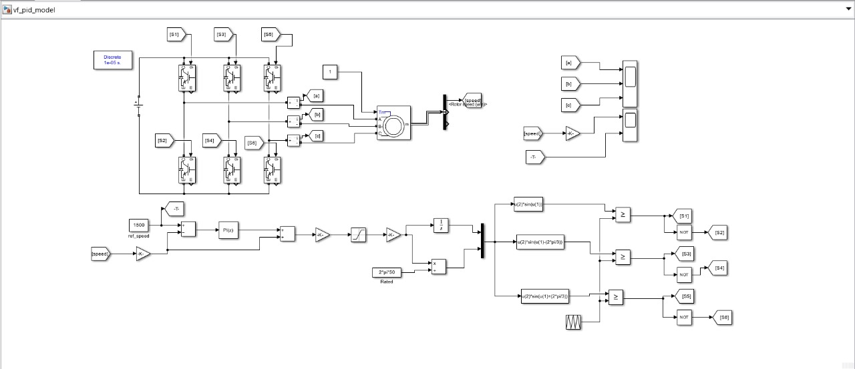
MATLAB Simulink model
P-I Control For Speed controlling in 3 phase induction motor
13

Slide 14
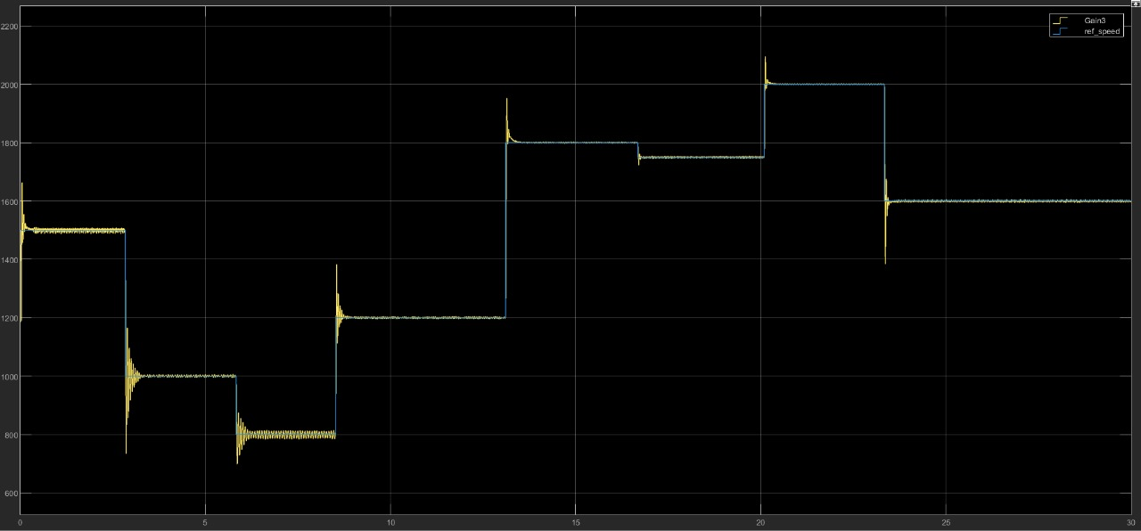
OUTPUT
14

Slide 15
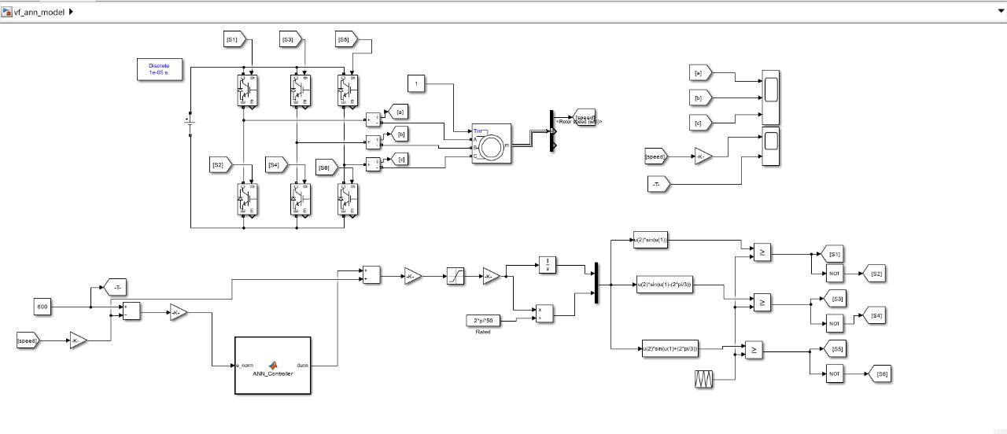
ANN based speed control
15

Slide 16
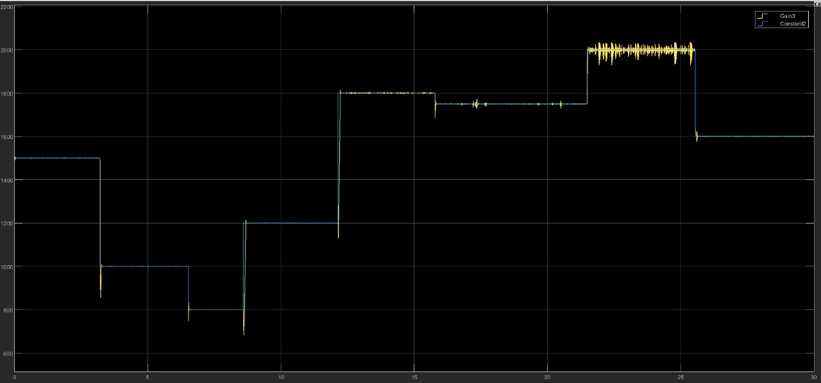
OUTPUT
16

Slide 17
USER INTERFACE DESIGN
User Interface (UI) is the connection point between the user and a digital system, enabling interaction and control.
A good UI helps users easily understand, navigate, and operate system features without confusion.
In our project, the UI allows users to login, select subheadings, and explore ANN-based motor speed control details.
The design focuses on a clean, attractive, and user-friendly experience using HTML, CSS (Flexbox), and a handwritten Housky font for aesthetics.
17

Slide 18
Objectives of UI Design
Enhance Usability: Ensure users can easily navigate, interact, and understand the system without requiring technical expertise.
Improve Visual Appeal: Create an attractive layout with good color schemes, fonts (Housky), and clear structure for a pleasant experience.
Streamline Navigation: Provide smooth transitions between login, subheadings, and content pages with minimal user effort.
Increase User Engagement: Make the interface intuitive and engaging, encouraging users to interact more with the ANN-based motor control system.
18

Slide 19

CONCLUSION
The Volts-per-Hertz (V/F) control method offers a simple and reliable solution for the speed regulation of 3-phase induction motors.
Using a PI controller in a closed-loop system improves accuracy and dynamic response compared to open-loop control.
The integration of an Artificial Neural Network (ANN) enhances adaptability and performance by learning from system behavior.
Simulation results in MATLAB/Simulink show improved speed tracking, torque smoothness, and response under varying load conditions.
The proposed ANN-based V/F control approach proves to be cost-effective, intelligent, and efficient, making it suitable for real-world industrial applications.
19

Slide 20
REFERENCES
H. M. D. Habbi, H. J. Ajeel, and I. I. Ali, “Speed Control of Induction Motor using PI and V/F Scalar Vector Controllers,” International Journal of Computer Applications, vol. 151, no. 7, pp. 36–43, Oct. 2016. [Online]. Available: https://doi.org/10.5120/ijca2016911831
R. Arulmozhiyal and K. Baskaran, “Implementation of a Fuzzy PI Controller for Speed Control of Induction Motor using FPGA,” IEEE Transactions on Industrial Electronics, vol. 56, no. 8, pp. 2475–2483, Aug. 2009. [Online]. Available: https://doi.org/10.1109/TIE.2008.2003205
Y. Wang, Z. Li, and X. Liu, “Speed Regulation of Induction Motor Using ANN-Based Control Strategy,” IEEE Transactions on Neural Networks and Learning Systems, vol. 27, no. 6, pp. 1293–1303, Jun. 2016. [Online]. Available: https://doi.org/10.1109/TNNLS.2015.2426672
20

Slide 21

THANK YOU
21

